Slide 1
OSML Intelligent Resource Scheduling for Co-located Latency-critical Services: A Multi-Model Collaborative Learning Approach
Lei Liu¹, Xinglei Dou² (Presenter), Yuetao Chen²
¹Beihang University; ²ICT, CAS; Sys-Inventor Lab
FAST-2023
Session: AI and Storage

Slide 2
Executive Summary
Runtime resource scheduling becomes the pivot for Quality of Service (QoS) control in complicated co-location cases.
Challenges:
Co-located services exhibit diverse behaviors across the storage hierarchy.
Enlarging scheduling exploration space and multiple interactive resources make it hard for schedulers to provide ideal solutions quickly and efficiently.
“Resource cliffs” (RCliff) reduces the exploration efficiency and lead to severe QoS fluctuations.
Solutions:
Data-driven approach based on extensive traces
Collaborative ML models for intelligent scheduling
Results:
higher loads and shorter convergence time than prior work

Slide 3
Outline
Motivation
Study in Resource Scheduling for LC services
Leveraging ML for scheduling
Evaluations
Conclusion

Slide 4
Monolithic Architecture → Loosely-coupled Design
Cloud applications are shifting from monolithic architectures to loosely-coupled designs, including many latency-critical (LC) services with strict quality of service (QoS) requirements.
Presentation layer
Service layer
Persistence layer
Monolithic architecture
Service A
Service B
Service C
Latency-critical services
Service D
Service E
Loosely-coupled design

Slide 5
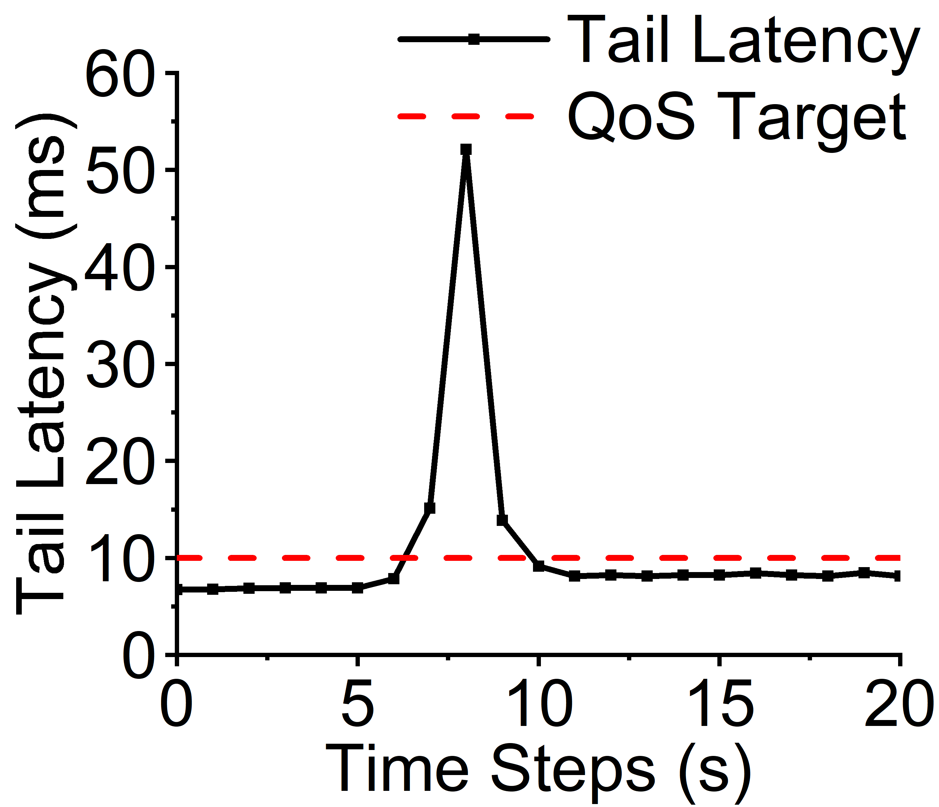
Co-location → Contention for Shared Resources
Co-located services exhibit diverse behaviors across the storage hierarchy, including multiple interactive resources such as CPU cores, last level cache (LLC), memory/IO bandwidth, and main memory banks.
Co-located services contend for shared resources, leading to Quality of Service (QoS) violations.
Core 1
L1/L2
Core 2
L1/L2
…
Core N
L1/L2
QoS violation
Service A
Service B
Last-level Cache
Memory Bandwidth
DRAM
QoS violations of
Latency-critical (LC) services
Contention in shared resources

Slide 6
New Scheduling Approaches are Expected
Existing schedulers still have room for improvement in scheduling convergence time, intelligence, and how to schedule complicated interactive resources in a timely fashion.
Existing schedulers cannot easily avoid “resource cliffs”, i.e., decreasing a resource only slightly during scheduling leads to a significant QoS slow-down.
?
CPU
LLC
B/W
Interactive resources
QoS violations

Slide 7
Outline
Motivation
Study in Resource Scheduling for LC services
Leveraging ML for scheduling
Evaluations
Conclusion

Slide 8
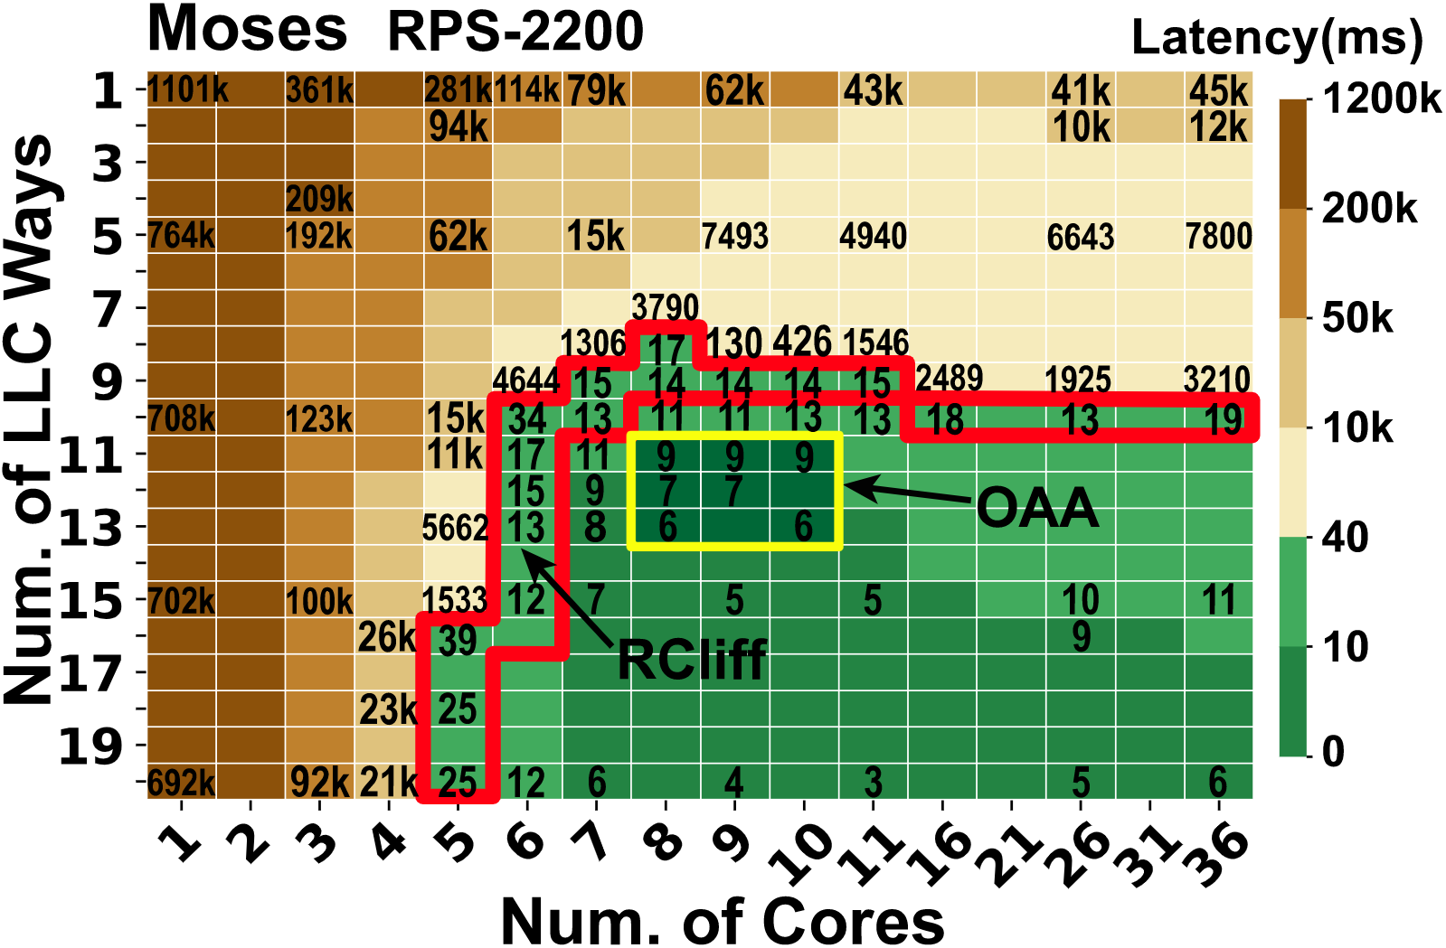
Key Observations: RCliff and OAA
Resource Cliff (RCliff): the resource allocation cases that could incur the most significant performance slowdown if resources (e.g., core, cache) are deprived of via a fine-grain way in the scheduling exploration space
Optimal Allocation Area (OAA): the ideal number of allocated cores and LLC ways to bring an acceptable QoS
A resource scheduling exploration space containing 36 (#cores) * 20 (#LLC ways) possible allocations
Each cell denotes the LC service’ s response latency under the given number of cores and LLC ways

Slide 9
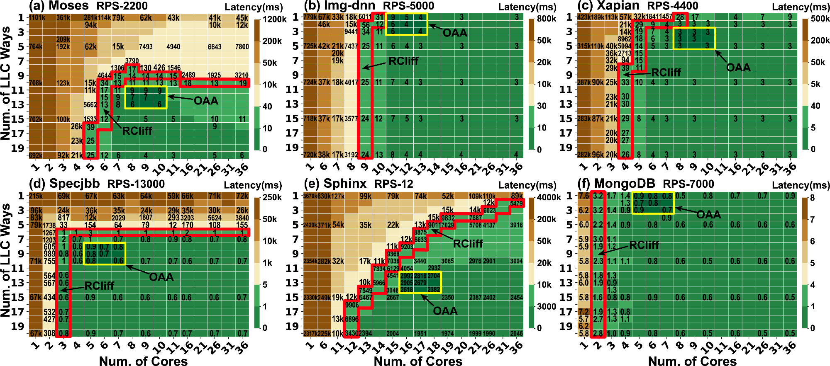
Key Observations: RCliff and OAA
RCliff and OAA commonly exist for many LC services.

Slide 10
Is OAA Sensitive to the Number of Threads?
More threads do not necessarily bring more benefits.
The OAA is not sensitive to the number of concurrent threads.
OAA exists regardless of the number of concurrent threads

Slide 11
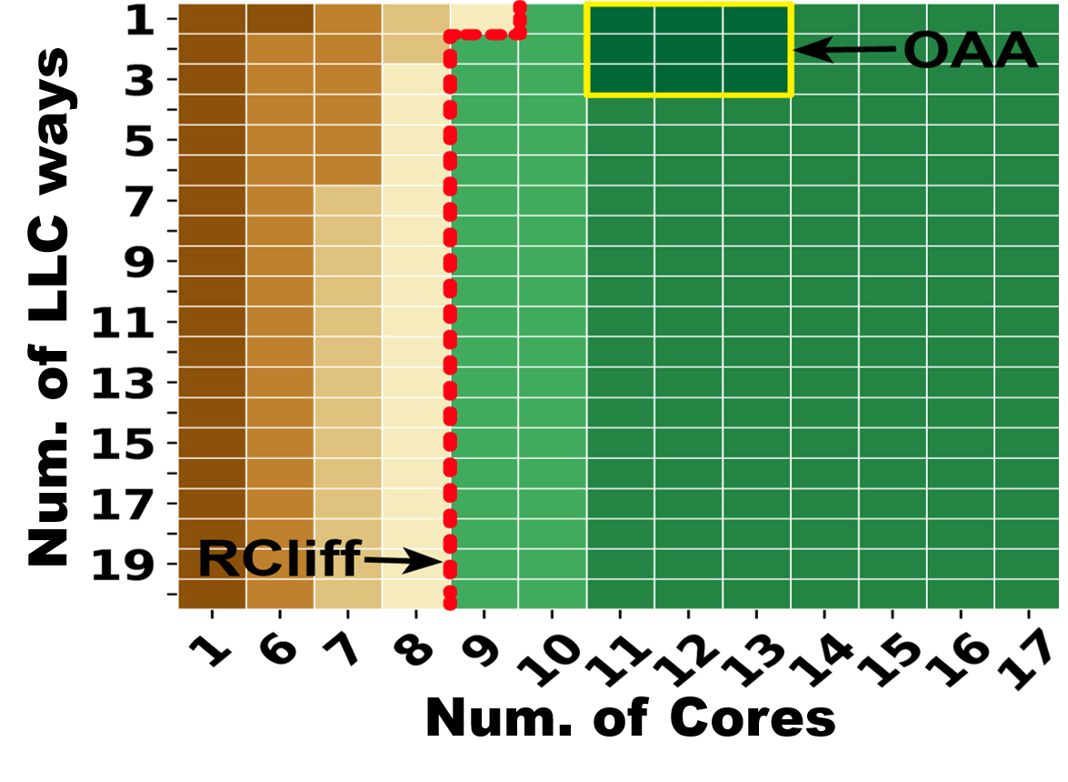
Issues the Existing Schedulers May Meet
Entangling with RCliffs
Difficulty in accurately and simultaneously scheduling a combination of multiple interactive resources (e.g., cores, LLC ways) to achieve OAAs in low overheads
Difficulty in providing accurate QoS predictions
Increasing resource step by step in a fine-grain way
Falling off the RCliff
Example: Existing schedulers are entangling with RCliffs

Slide 12
Outline
Motivation
Study in Resource Scheduling for LC services
Leveraging ML for scheduling
Evaluations
Conclusion

Slide 13
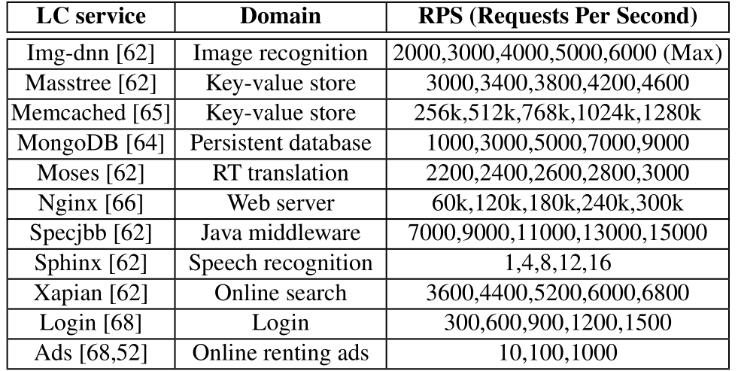
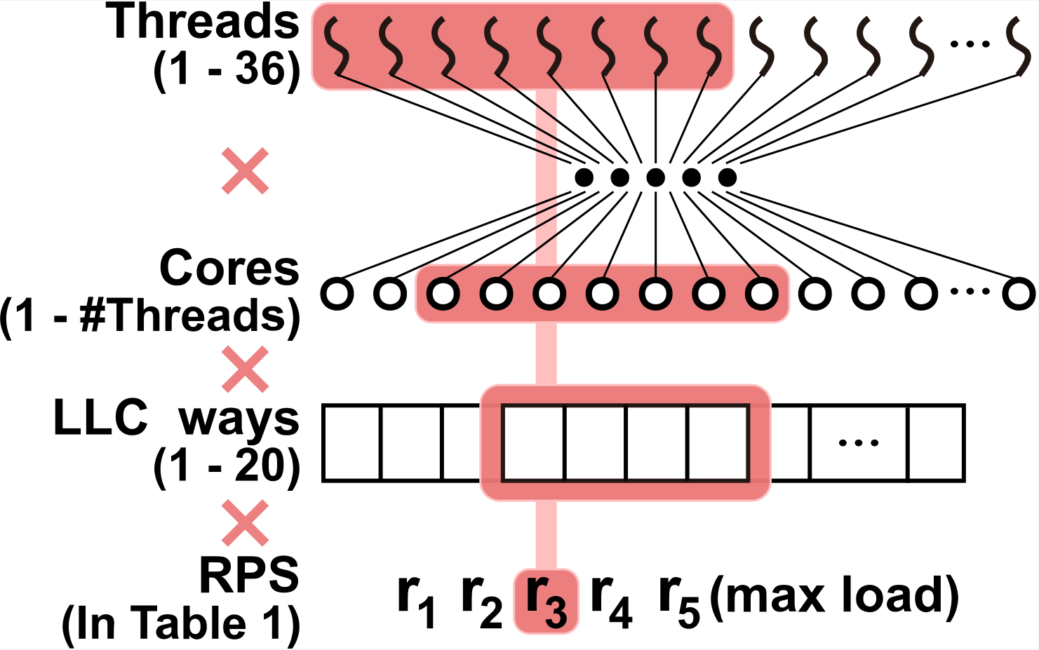
OSML - a Data-driven Approach
Data collection
11 representative LC services
Common RPS demands
1-36 threads
Data set from 11 typical LC services
62,720,264 resource allocation cases, containing around 2-billion samples
Map on 1 - #Threads cores
1-20 LLC ways

Slide 14
OSML – Using ML for Resource Scheduling
Multi-model collaborative learning approach
Model-A: Aiming Optimal Allocation Area
Model-B: Balancing QoS and Resources
Model-C: Handling the Changes On the Fly
OSML is designed as a co-worker of the OS scheduler located between the OS kernel and the user layer

Slide 15
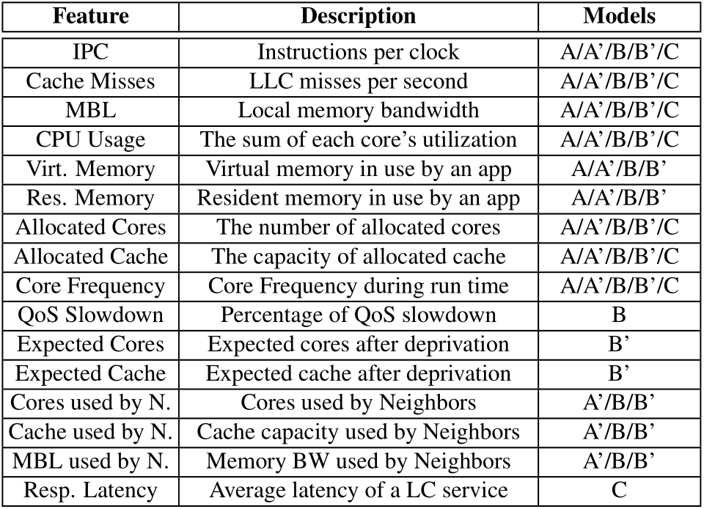
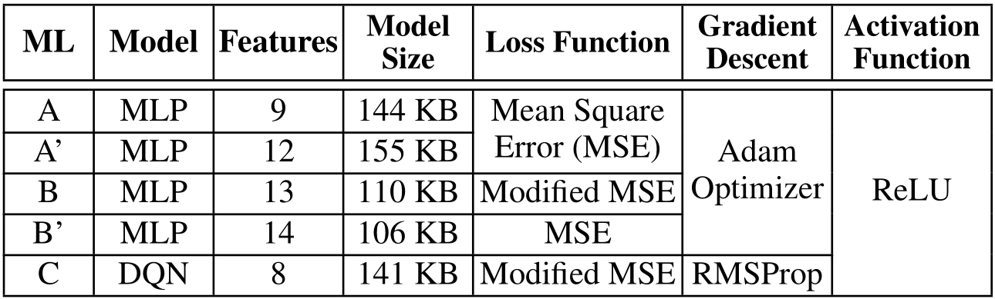
Summary of the ML Models
Inputs
Models
outputs
Model-A
(MLP)
Outputs:
RCliff, OAA, OAA bandwidth (for a single service)
Format:
<RCliff cores, RCliff LLC ways, OAA cores, OAA LLC ways, [OAA bandwidth]>
Model-A’
(MLP)
Outputs:
OAA, RCliff, OAA bandwidth (for co-location cases)
Format:
<RCliff cores, RCliff LLC ways, OAA cores, OAA LLC ways, [OAA bandwidth]>
Model-B
(MLP)
Outputs:
The resources that a service can be deprived of under allowable QoS slowdown
Format:
<Cores, LLC ways>, <Cores (dominated), LLC ways>, <Cores, LLC ways (dominated)>
Details of the ML models
Model-B’
(MLP)
Outputs:
How much QoS slowdown will suffer if a certain amount of resources is deprived of a specific service
Format:
<QoS slowdown>
Model-C
(DQN)
Outputs:
The scheduling actions (reducing/increasing a specific number of cores/LLC ways)
Format:
<Core step, LLC way step>

Slide 16
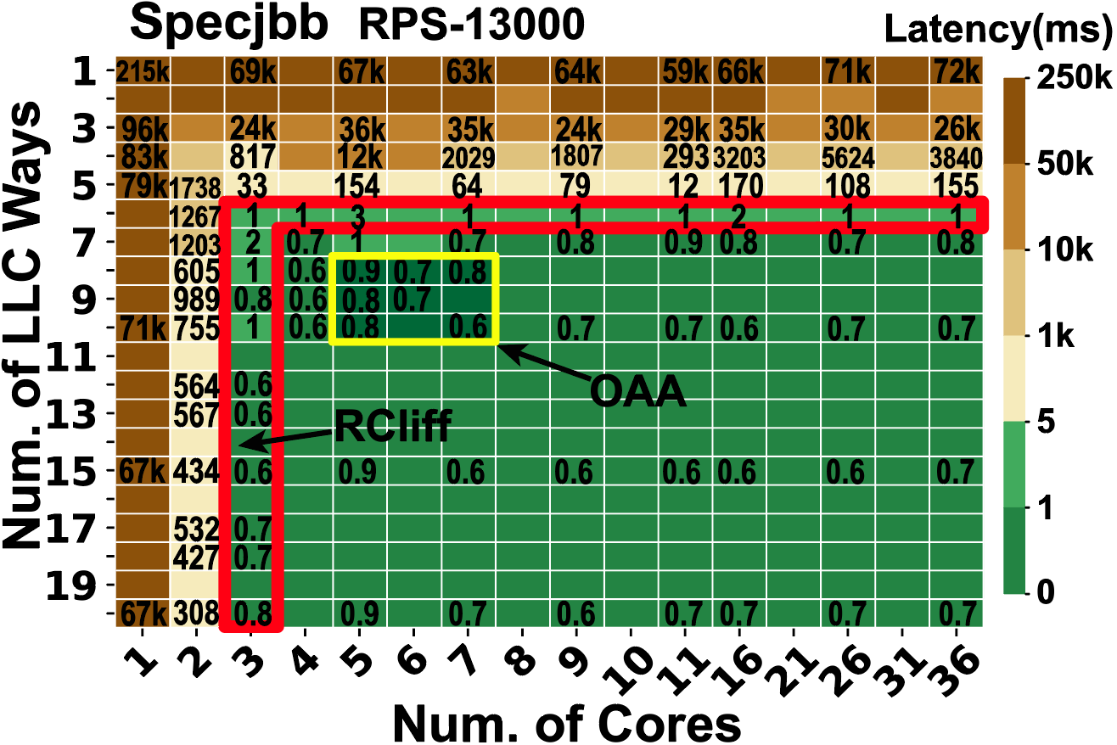
Model-A: Aiming OAA
Model-A predicts RCliff, OAA and OAA bandwidth.
Model-A inputs:
<IPC, Cache Misses, MBL, CPU Usage, Virt. Memory, Res. Memory, Allocated Cores, Allocated Cache, Core Frequency>
Model-A outputs:
<RCliff cores, RCliff LLC ways, OAA cores, OAA LLC ways, OAA bandwidth>
Model-A’ is used in co-location cases.
Model-A’ inputs:
Input features of Model-A
<Cores used by neighbors, Cache used by neighbors, Memory BW used by neighbors>
Model-A’ outputs:
Same as Model-A

Slide 17
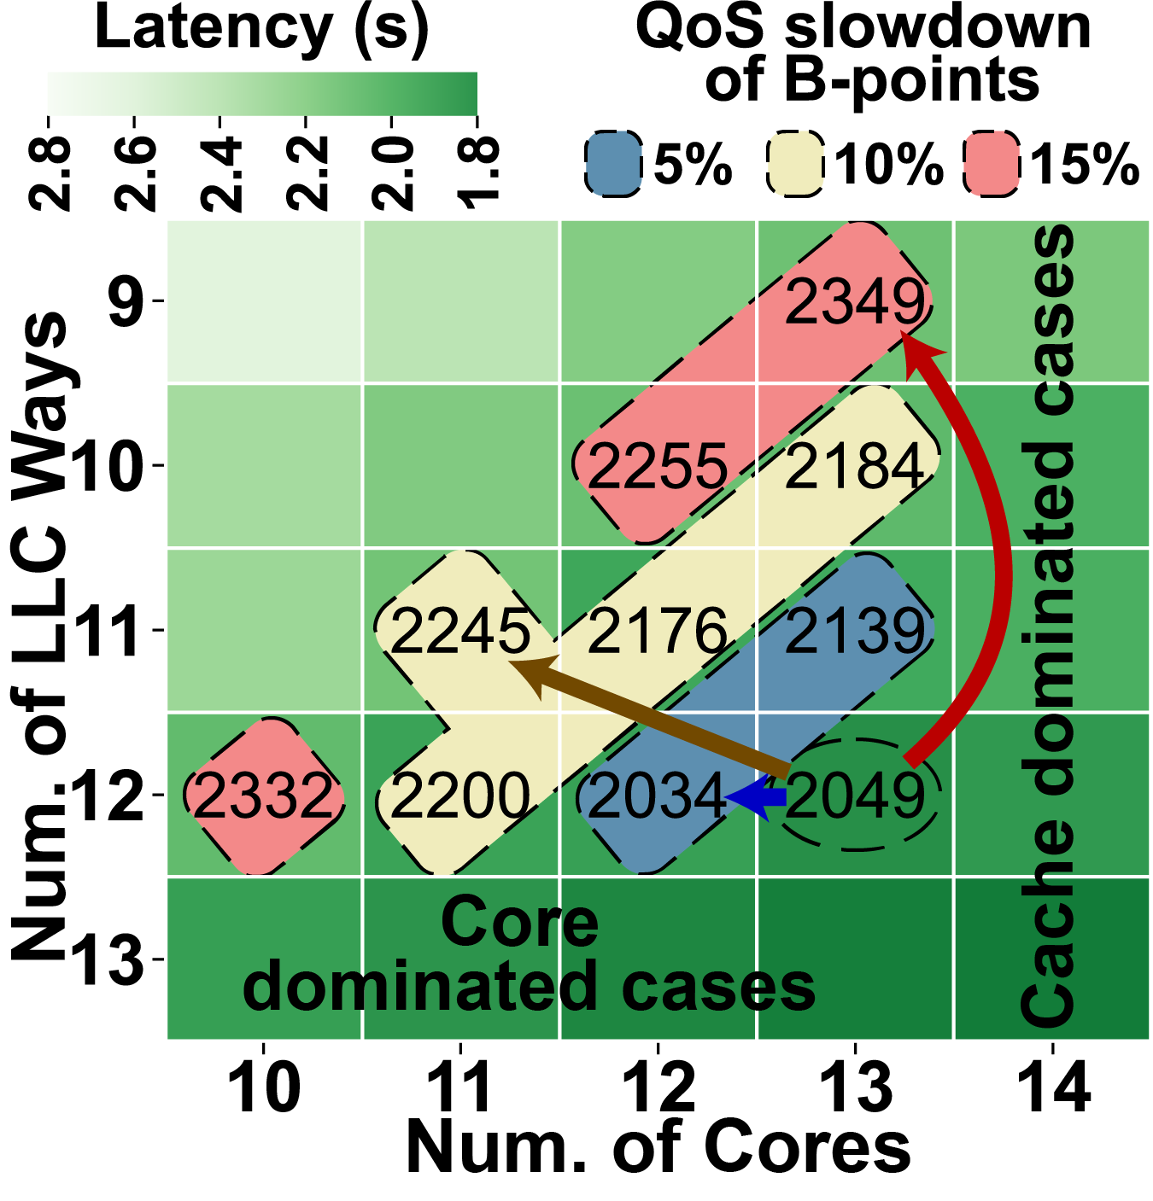
Model-B: Balancing QoS and Resources
Model-B balances the QoS and resource allocations among co-located LC services.
Model-B inputs:
Input features of Model-A’
QoS Slowdown
Model-B outputs 3 policies as the computing units and memory resource can be fungible:
<Cores, LLC ways>, <Cores (dominated), LLC ways>, <Cores, LLC ways (dominated)>
Model-B’ predicts QoS slowdown if a certain amount of resources is deprived of a specific service.
Model-B’ inputs:
Input features of Model-A’
<Cores after deprivation, Cache after deprivation>
Model-B’ outputs:
QoS slowdown
Notes:
Model-B’ inputs:
Input features of Model-A’
<Cores after deprivation, Cache after deprivation>

Slide 18
Model-C: Handling the Changes On the Fly
Model-C shepherds the allocations and recovers from the QoS violation and resource over-provision cases.
Model-C inputs:
<IPC, Cache Misses, MBL, CPU Usage, Allocated Cores, Allocated Cache, Core Frequency, Response Latency>
Action:
{<m,n> | m ∈ [−3,3], n ∈ [−3,3]}
m indicates the action on cores; n indicates the action on LLC ways.
Reward:
If Latency_{t−1} > Latency_{t} :
R_{t} = log(1+Latency_{t−1}−Latency_{t})−(∆CoreNum+∆CacheWay)
If Latency_{t−1} < Latency_{t} :
R_{t} = −log(1+Latency_{t} −Latency_{t−1})−(∆CoreNum+∆CacheWay)
If Latency_{t−1} = Latency_{t} :
R_{t} = −(∆CoreNum+∆CacheWay)
Mitigate QoS violations
Minimize resource usage
DQN agent
Status
Reward
Action
Environment

Slide 19
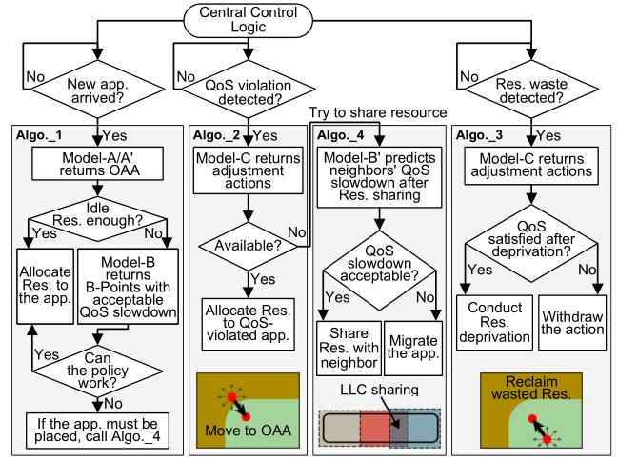
Central Logic - Using ML Models in a Pipelined Way
Algorithm 1: Allocating resources for a coming LC service
Enable Model-A/A’ to get the OAA and RCliff
If idle resources are sufficient to satisfy the new LC service, then allocate resources to the service
If not, enable Model-B to deprive resources from neighbors and allocate them to the new one
Enable resource sharing if necessary

Slide 20
Central Logic - Using ML Models in a Pipelined Way
Algorithm 2: Handling resource under-provision cases
Call Model-C to allocate more resources to achieve ideal QoS
Enable resource sharing if necessary

Slide 21
Central Logic - Using ML Models in a Pipelined Way
Algorithm 3: Handling resource over-provision cases
Call Model-C to reclaim over-provisioned resources
Withdraw the action if QoS is not satisfied after the deprivation

Slide 22
Central Logic - Using ML Models in a Pipelined Way
Algorithm 4: Handling resource sharing among apps
Enable Model-B’ to predict QoS slowdown after resource sharing
If the slowdown is acceptable, share resource with neighbor
If not, migrate the application

Slide 23
Outline
Motivation
Study in Resource Scheduling for LC services
Leveraging ML for scheduling
Evaluations
Conclusion

Slide 24
Methodology
Platform:
Intel Xeon E5-2697 v4, 36 logical cores (18 physical cores), 45MB LLC, 20 LLC ways.
Capture traces using:
pqos tool [1]
PMU
Isolation mechanisms:
CPU cores - Linux taskset
LLC ways - Intel Cache Allocation Technology (CAT) [1]
Memory bandwidth - Intel Memory Bandwidth Allocation (MBA) [2]
[1] “Improving real-time performance by utilizing cache allocation technology,” https://www.intel.com/content/dam/www/public/us/en/documents/white-papers/
cache-allocation-technology-white-paper.pdf, Intel Corporation, April, 2015.
[2] “Intel 64 and IA-32 Architectures Software Developer’s Manual,” https://software.intel.com/en-us/articles/intel-sdm, Intel Corporation, October, 2016.

Slide 25
Evaluations
Metrics:
Quality of Service (QoS, QoS target is the 99th percentile latency of the knee of the latency-RPS curve)
Effective Machine Utilization (EMU, the max aggregated load of all co-located LC services)
Competing approaches:
PARTIES [1], a heuristic scheduling approach
CLITE [2], based on Bayesian optimizer
Unmanaged Allocation
ORACLE, the best allocation policy obtained by exhaustive offline sampling
[1] Shuang Chen, Christina Delimitrou, José F. Martínez, “PARTIES: QoS-Aware Resource Partitioning for Multiple Interactive Services,” in ASPLOS, 2019.
[2] Tirthak Patel, Devesh Tiwari, “CLITE: Efficient and QoS-Aware Co-Location of Multiple Latency-Critical Jobs for Warehouse Scale Computers,” in HPCA, 2020.

Slide 26
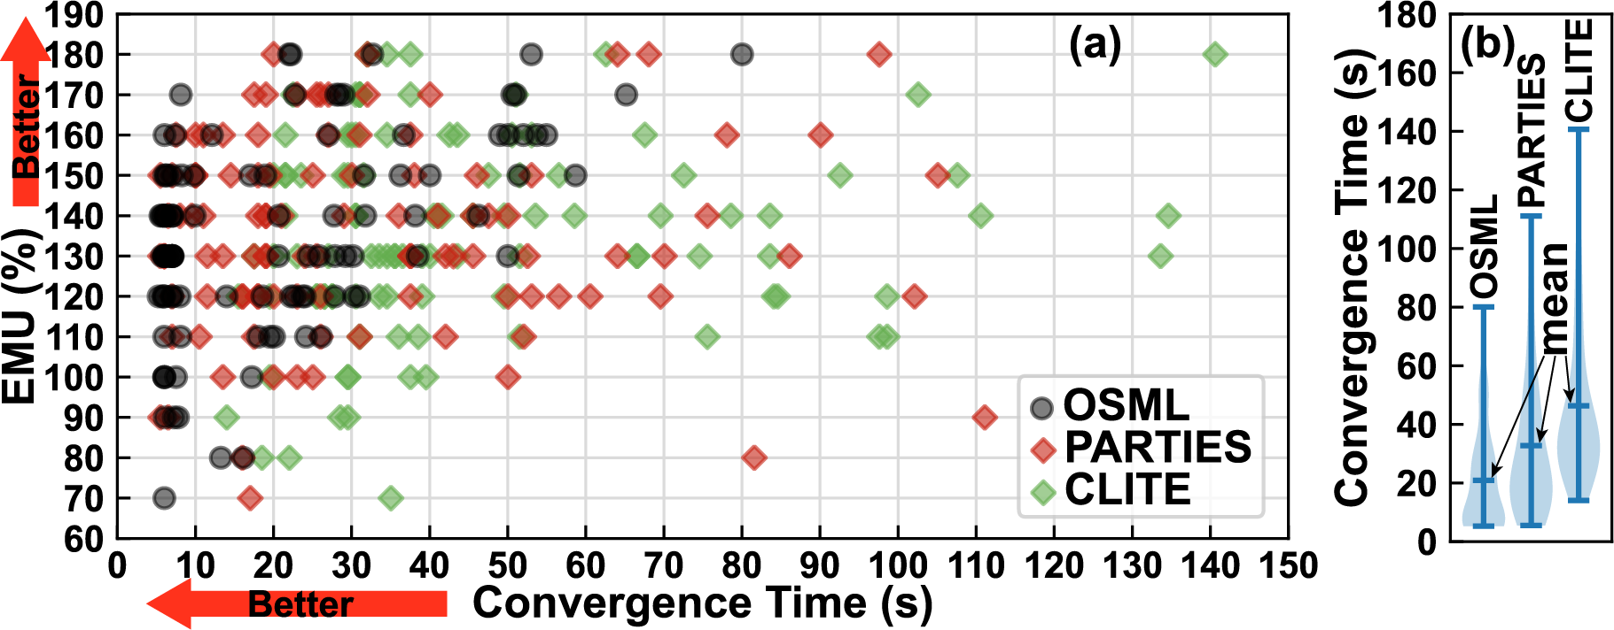
Performance Distribution
OSML can achieve the same EMU with a shorter convergence time for a specific load.
OSML converges faster mainly because the start point provided by Model-A is close to OAA.
Scheduler | Average Convergence Time
OSML | 20.9s
PARTIES | 32.7s (1.56×OSML)
CLITE | 46.3s (2.22×OSML)
The performance distribution for 104 loads that OSML and other baselines can all converge.
Violin plots of convergence time for loads in (a).
OSML converges 1.56× and 2.22× faster than the baseline approaches.

Slide 27
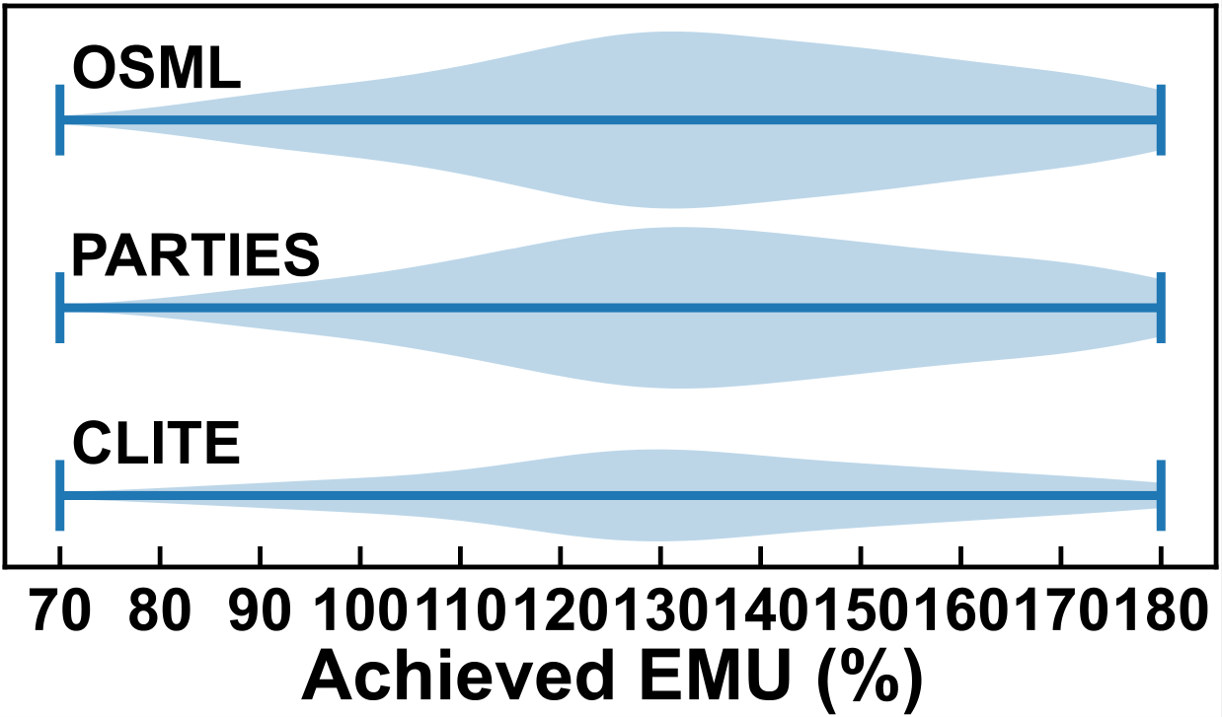
EMU Distribution
OSML works for more loads across different EMUs, particularly in cases where the EMU is high (e.g., 130%~ 180%).
Scheduler | Number of Converged loads
OSML | 285 (94.4%)
PARTIES | 260 (86.1%)
CLITE | 148 (49.0%)
EMU distribution for converged loads among 302 loads.
OSML, PARTIES, and CLITE works for 94.4%, 86.1%, and 49.0% loads, respectively.
Each resource scheduler has its own pros and cons, suited for different cases.

Slide 28
Resource Usage Comparisons
Case A: Moses, Img-dnn, and Xapian with 40%, 60%, and 50% of their maximum loads.
Less Resource Usage: OSML saves 3 cores and 9 LLC ways, other baselines use all resources on the platform.

Slide 29
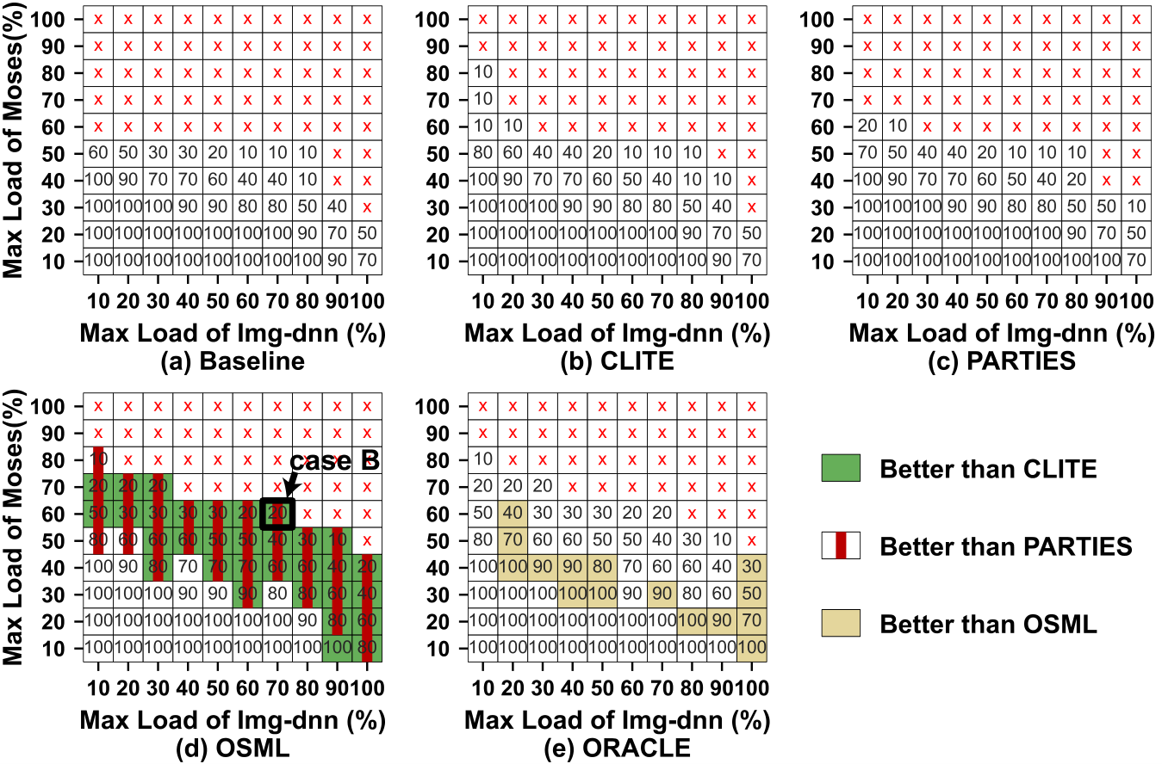
Achieved Loads
OSML provides solutions for sharing some cores and LLC ways among LC services, therefore supporting higher loads.
Case B: Moses, Img-dnn, and Xapian with 60%, 70%, and 20% of their maximum loads.
Higher Loads: OSML converges by sharing resources. The baselines can not converge for this load.
Workload: Moses, Img-dnn, and Xapian

Slide 30
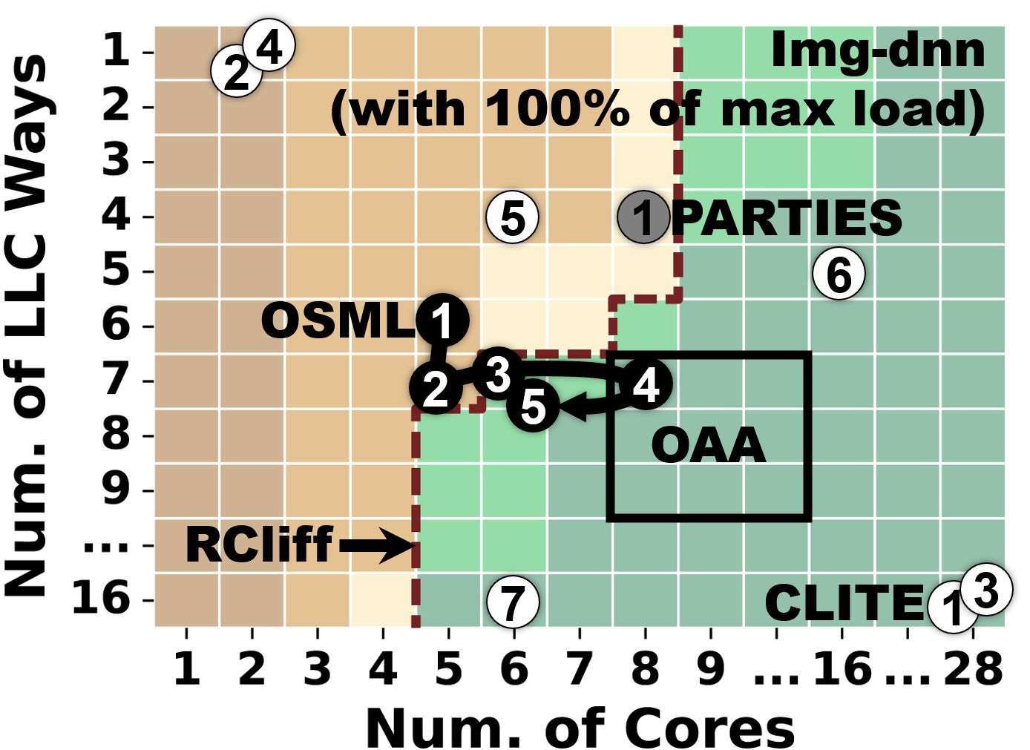
Performance for Workload Churn
16s~80s: New service arrives
OSML provides better scheduling solutions at time point 48 for all three services.
180s~228s: Img-dnn’s load increases
OSML meets Img-dnn’s changing demand with Model-C.
Scheduling traces during 180s~228s

Slide 31
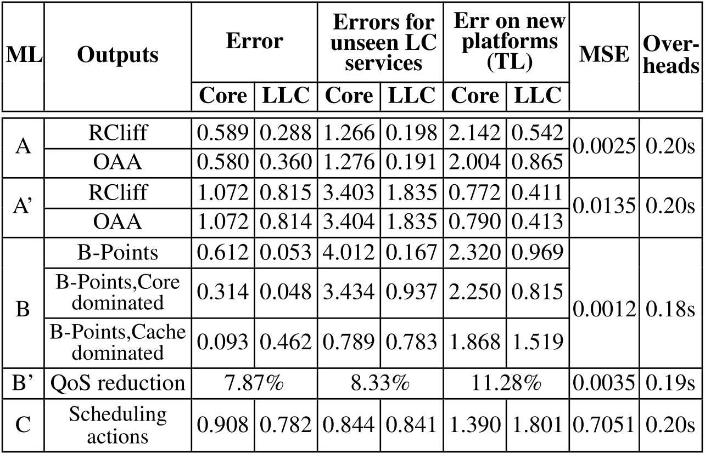
Generalization
Performance for all unseen applications
OSML converges 1.38×~1.50×faster than baselines.
Model errors
Errors are not significant.
Model-A/B outputs approximate OAA, Model-C schedules and learns online.
OSML is a long-term project open to the community; we continue adding new traces collected from new applications and new servers to the data set for enhancing models’ performance for new cases.

Slide 32
Conclusion
OSML is an ML-based resource scheduler for co-located LC services.
OSML uses multiple ML models cooperatively in a pipe-lined way.
Leveraging ML could have an immense potential for OS design.
In a world where co-location and sharing are a fundamental reality, our solution should grow in importance and benefits our community.

Slide 33
Thank You!
Lei Liu¹, Xinglei Dou², Yuetao Chen²
¹Beihang University; ²ICT,CAS; Sys-Inventor Lab
https://liulei-sys-inventor.github.io/

